Slide 1
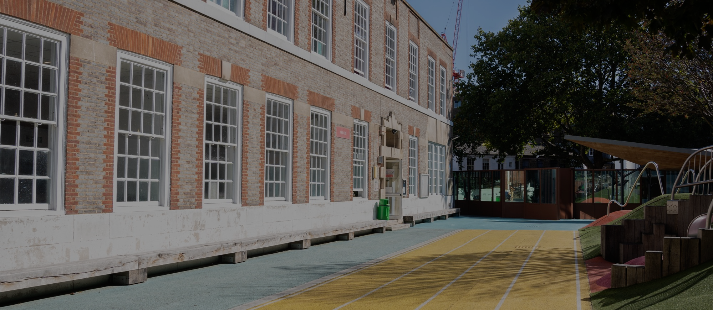


HOW TO APPLY FOR A PLACE AT THE
LYCÉE FRANÇAIS CHARLES DE GAULLE DE LONDRES
APPLICATION & ADMISSION PROCEDURES

Slide 2


Offers of places are issued after each Admissions Board meeting. There are several board meetings throughout the year. Deadlines for each round are shown in the calendar on our website (Admissions → French curriculum → First application for a place). Please submit one online application per child. At the end, make sure to click “Submit”; we cannot access applications that are still in progress.
To do this, you will need to create an account on the online platform using your first name and family name. We suggest you read this guide before proceeding to avoid common mistakes which could slow down the registration process or make your application invalid.
Click on “Registrations”, then on “New Registration” under the section “Add a child”. Follow the 6 steps, making sure you complete all mandatory fields (boxed in red). Please check that the pre-registration file is submitted in the child’s name - not the parent’s. Do not change the “Expected entry date” even if your planning for an in-year admission. On step 4, adding the name and contacts of the child’s second legal guardian is mandatory (if there is one). On Step 5, upload all supporting documents in one go and click on Step 6 “Confirmation”. You will receive an automatic email confirming completion of your submission. Please delete any complete or incomplete or duplicate files to avoid confusion.
Applications will be reviewed by the admissions board committee by order of priority such as highlighted in the Lycée’s Admissions Priority Criteria. Decisions are then notified by email to families within the deadlines featured in our calendar. Please do check your "Junk Mail" around said dates. Our messages are sent via a mass mailing platform and some inboxes are set up to block these emails. Alternatively, you can add inscription@lyceefrancais.org.uk to your contact list to ensure you receive all our communications. We do not share decisions over the phone.
ENROLMENT PROCESS OVERVIEW
Notes:
SON NEW

Slide 3
SUPPORTING DOCUMENTS
Copy of full Family Record Book The document must show the names of the parents and the child. In the case of a birth certificate issued abroad, it must be translated if no mention appears in English or French in the original document;
Photocopy of valid passports for parents and child. Passports are preferred. The names must match those on the family record book or the birth certificate;
Admission application form The signatures of both legal guardians are required for each of the three sections of this document. If one parent has sole authority over educational decisions, a copy of the court ruling will be requested. A genuine signature is required - no typed name;
Residence title * For British or Irish pupils, please upload their British or Irish passport. For other nationals who are already in the UK at the time of registration, please upload proof of the child’s right to reside and study in the UK: Dependent child visa/pre-settled/settled status/diplomatic exemption. For other nationals who do not live in the UK at the time of registration, proof of your child’s right to study in the UK needs to be sent before September 2026. Please note that ETAs (tourist visa) are not accepted. Your child will not be authorized to start school before his/her right to reside and study in the UK is confirmed;
Proof of address in London (utility bill, tenancy agreement)*: This document should be in the name of at least one parent and less than 6 months old;
Certificate of attendance: Madatory for all children except for Marternelle applications (PS, MS or GS) if the child does not already attend a school or a nursery.
Last two years of the child’s school reports (bulletins)
Please insert all reports for 2024–2025 (3 terms or 2 semesters).
2025–2026 school reports must be sent to inscription@lyceefrancais.org.uk before Sunday, June 28, 2026.
For nursery classes, in the absence of school reports, please join any document outlining the child’s progress:
Vaccination record it must show the child’s name and list all the vaccines received;
Special Educational Needs If your child has special educational needs, a disability, a learning difficulty, and/or a medical condition, please upload the PAP/PAI/EHCP or “Individual Education/Wellbeing Plan” set up by their current school. Once the pre-registration file has been submitted, please contact inscription@lyceefrancais.org.uk.
Fiche de dialogue For pupils studying in the French education system and applying for 2nde or 1ère, parents will need to send the “Fiche de Dialogue” to inscription@lyceefrancais.org.uk by June 28, 2026;
* Families who are not in the UK at the time of application will need to submit their proof of address and child’s proof of right to reside in the UK to inscription@lyceefrancais.org.uk by August 23, 2026.
Notes:
SON NEW

Slide 4




REGISTERING FOR PRIMARY SCHOOL
We have 4 primary “annexes” in London:
ÉCOLE PRIMAIRE MARIE D’ORLIAC (in Fulham) starting in Petite Section and with two bilingual streams from Moyenne Section: “Anglais Renforcé" (enhanced English) or “Parité Horaire" (50% in French and 50% in English)
ÉCOLE PRIMAIRE DE SOUTH KENSINGTON (in South Kensington) starting in Petite Section with a bilingual enhanced English stream
ÉCOLE PRIMAIRE DE WIX (in Clapham) starting in Moyenne Section with two bilingual streams: “Anglais Renforcé" (enhanced English) or “Parité Horaire" (50% in French and 50% in English)
ÉCOLE PRIMAIRE ANDRÉ MALRAUX (in Ealing) starting in Petite Section with a bilingual enhanced English stream
Please find more information about our different schools here
Children from a non-French system (except for PS, MS and GS) will have to take a French test with the school’s director if a place is offered to them. This test usually consists of oral questions.
Children who apply for “Parité Horaire” must have a corresponding level of English. If they come from a non-UK system, they will have to pass an English test before being accepted.
Notes:
SON NEW

Slide 5
ASPECTS TO CONSIDER WHEN ENROLING AT OUR PRIMARY SCHOOLS
“Preregistration” => “Formation”: please select the first school/stream of your choice. Moving to Step 3, you will be given the option to add two further choices ("Add wish“). Please note you should not create a different file for each additional school choice.
For pupils who have never attended school (some PS, MS and occasionally GS levels), a mandatory field appears in the second section for the former school’s email and address. Please indicate N/A if this is the case.
We follow the French registration calendar (which is different from the UK calendar). Here are the levels to register your child for 2026/27 according to their year of birth. Please check carefully that you are choosing the level for your child’s according to their year of birth - regardless of the month they were born.
Child’s birth year | Level to be registered for a start of school in September 2026/2027
2023 | PS
2022 | MS
2021 | GS
2020 | CP
2019 | CE1
2018 | CE2
2017 | CM1
2016 | CM2
Notes:
SON NEW

Slide 6
REGISTERING FOR THE SECONDARY SCHOOL
We offer 2 different curricula: Section Plurilingue (SP) and Section Internationale (SI). More information is available here. Please note that places are exclusively offered in SP. We never offer places directly for SI. Children will first be enroled in SP and only then may they chose to apply for SI.
For 6ème, if your child is enroled (not just pre-enroled) by February 6, 2026 he/she will be invited to sit the SI entrance test. However, if enrolment takes place after that date, they will remain in SP for the duration of 6ème. Subject to successful completion of an entrance test and availability of places, they may be able to join 5ème SI the following year.
From 5ème upwards, If your child is already enroled in a British SI (either in France or AEFE) and you wish them to continue in that track, you must notify us as soon as your child’s enrolment is confirmed. Our ability to offer a place in SI will depend on availability.
Only at the very end of the school year will our academic teams will be able to review availabilities. Children who are not currently studying in British SI in a French school, will need to sit an exam which will be held at the end of the school year or early September.
Notes:
SON NEW

Slide 7
ASPECTS TO CONSIDER WHEN ENROLING YOUR CHILD
Unaccompanied children: Children must reside with at least one legal guardian. No student can enrol in our school if they are staying with a host family, relatives other than their legal guardians or in student halls or similar.
We follow the French registration which is based on calendar years. The table to the side shows the year you should register your child for 2026/27 according to their year of birth (regardless of the month they were born). Please check carefully before choosing the level for your child.
Children from a non-French system will have to take a written test in French and mathematics if a place is offered to them.
Offers of places are subject to the child successfully completing his/her year. In the event the child is held back to repeat the year (“redoublement”), families must contact our teams to assess if the registration can be modified accordingly.
The British Section prepares for GCSEs and A levels and starts in Year 10 (equivalent to 3ème). The admission process is different to the admission process in the French section. Please refer to: “Admissions” => “British Curriculum” on our website.
Child’s birth year | Level to be registered for a start of school in September 2026/2027
2015 | 6ème
2014 | 5ème
2013 | 4ème
2012 | 3ème
2011 | 2nde
2010 | 1ère
2009 | Terminale
Notes:
SON NEW

Slide 8
ADMISSION COMMITTEE DECISIONS:
Following the Enrolment Committee meeting, you will be informed of the outcome.
If you receive an offer for a place, one of the following will apply:
Place subject to test: Please confirm your child’s attendance to the test whether he/she is allowed to leave on his/her own afterwards (Collège/ Lycée);
Incomplete application: Occasionally, applications will be incomplete or erroneous. We’ll write to you to let you know about the missing information and provide you with a deadline to come back to us. Unless the missing information is received before the deadline, the place may be cancelled.
Pay the First Registration Fees (DPI- Droits de Première Inscription). You will have a few days to make this payment. Once the DPIs are received, we will send you an email confirming that your child is enroled for the year 2026/27.
The DPI are non-refundable and cannot be carried forward for a registration in a later school year. If the deadlines are not met, the offer of the place will be withdrawn.
If you are notified that your child has not been offered a place: We will ask whether you would like your child’s application to be considered again at the next board of admissions meeting. Please ensure to respond to this email as this is not an automatic process.

