Slide 1
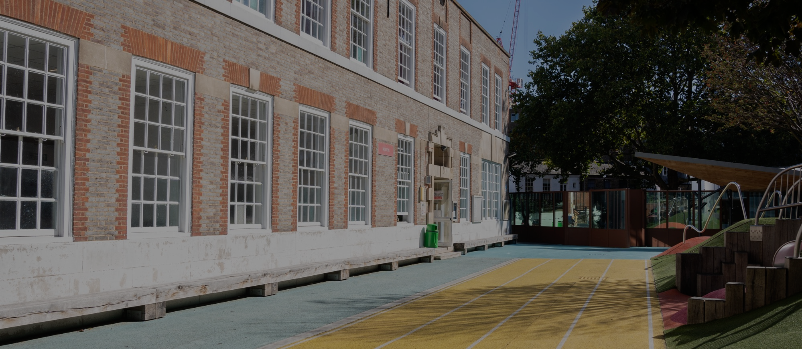


APPLYING FOR A PLACE IN
BRITISH SECTION
AT LYCEE FRANCAIS CHARLES DE GAULLE

Slide 2


To pre-register you child in British Section with our school , you will need to create an account on the online platform using your first name and family name. We suggest you read this guide before proceeding to avoid common mistakes which could slow down the registration process or make your application invalid.
Click on “Registrations”, then on “New Registration” under the section “Add a child”. Follow the 6 steps, making sure you complete all mandatory fields (boxed in red). Please check that the pre-registration file is submitted in the child’s name - not the parent’s. Do not change the “Expected entry date” even if your planning for an in-year admission. On step 4, adding the name and contacts of the child’s second legal guardian is mandatory (if there is one). On Step 5, upload all supporting documents in one go and click on Step 6 “Confirmation”. You will receive an automatic email confirming completion of your submission. Please delete any complete or incomplete or duplicate files to avoid confusion.
ENROLMENT PROCESS OVERVIEW
Notes:
SON NEW

Slide 3
SUPPORTING DOCUMENTS
Copy of full Family Record Book The document must show the names of the parents and the child. In the case of a birth certificate issued abroad, it must be translated if no mention appears in English or French in the original document;
Photocopy of valid passports for parents and child. Passports are preferred. The names must match those on the family record book or the birth certificate;
Admission application form The signatures of both legal guardians are required for each of the three sections of this document. If one parent has sole authority over educational decisions, a copy of the court ruling will be requested. A genuine signature is required - no typed name;
Residence title * For British or Irish pupils, please upload their British or Irish passport. For other nationals who are already in the UK at the time of registration, please upload proof of the child’s right to reside and study in the UK: Dependent child visa/pre-settled/settled status/diplomatic exemption. For other nationals who do not live in the UK at the time of registration, proof of your child’s right to study in the UK needs to be sent before September 2026. Please note that ETAs (tourist visa) are not accepted. Your child will not be authorized to start school before his/her right to reside and study in the UK is confirmed;
Proof of address in London (utility bill, tenancy agreement)*: This document should be in the name of at least one parent and less than 6 months old;
Certificate of attendance: Madatory for all children except for Marternelle applications (PS, MS or GS) if the child does not already attend a school or a nursery.
Last two years of the child’s school reports (bulletins)
  Please insert all reports for 2024–2025 (3 terms or 2 semesters).
  2025–2026 school reports must be sent to inscription@lyceefrancais.org.uk before Sunday, June 28, 2026.
  For nursery classes, in the absence of school reports, please join any document outlining the child’s progress:
Vaccination record it must show the child’s name and list all the vaccines received;
Special Educational Needs If your child has special educational needs, a disability, a learning difficulty, and/or a medical condition, please upload the PAP/PAI/EHCP or “Individual Education/Wellbeing Plan” set up by their current school. Once the pre-registration file has been submitted, please contact inscription@lyceefrancais.org.uk.
* Families who are not in the UK at the time of application will need to submit their proof of address and child’s proof of right to reside in the UK to inscription@lyceefrancais.org.uk by August 23, 2026.
Notes:
SON NEW

